Slide 1


CSE1901 - TARP
IoT enabled risk monitoring system in Cold Supply Chain
Technical Answers for Real World Problems
~Prof. Geetha S
Get Started

Slide 2







Team Members
AMRUTHA MS
20BCE1665
CSE1901 - TARP
VAISHNAVI JS
20BCE1571
AMRITANSH ANAND
20BCE1650
NAVYA KALA SV
20BCE1858
Sakshi Singh
20BCE1324
Continue

Slide 3

Problem Statement
We all know about cold storage, so why do we need
a better approach to it ?
We can consider the time of COVID-19, criminal and nation-state-based actors were actively attacking organizations involved in COVID-19 vaccine delivery efforts. These threats exist at an industry level and we want to be proactive in helping owner/operators mitigate any possible incidents. Any disruption to the delivery of COVID-19 vaccines may impact public health and the economy. Which makes up the need of physical security for cold storage locations.
Continue

Slide 4

Continued...
Temperature and humidity measurement, is important in cold storage because it can affect the health and safety of personnel as well as the cost of the product. Stored items may be ruined in warm or humid conditions. Also, maintaining proper temperature levels in medical cold storage areas is critical. Incorrect temperatures can compromise the medications or vaccines stored in medical refrigerators. High temperature and high humidity are the two most important factors in drug degradation. When exposed to these conditions, the medications can weaken.

Slide 5


Abstract
We would like to introduce cold storage which has been divided into parts, Starting at the entrance we will place a PIR sensor and it will be useful to detect a person and the gate gets open also there would be a 360 degrees rotatable camera using 6 pole stepper motor, There would be a 2x2 keypad interfacing for opening the doors of those four rooms as discussed earlier. If we press 1 “Room 1” gets open and it will show the temperature, humidity values using 7 segment LCD Display. Similarly, for the rest, Temperature and Humidity are user friendly, it can be varied based upon the items we store in those rooms, and using those temperature and humidity sensors set by us it will be connected to a buzzer if a temperature is dropping by rather than the temperature we set, Buzzer will get on, Buzzer is common to all the rooms but to check from where the buzzer is, We set a led interfacing and those LEDs will be connected with a keypad and the respective room “LED” will blink in the keypad, From it, we can sense in which room the temperature and humidity levels are dropping.
99% Malware Detection Removal
Learn More

Slide 6


Also, the freezers and coolers will be turned on and off based on the temperature levels sensed by the sensors to minimize the electricity.
Gas Leakages, If there is any pressure drop the entire flow of gas will be stopped and for it, a gas sensor will be placed at the center of the cold reservoir, and in the sensor, the materials which react with the gasses we send will be placed, and if there is any gas leak based upon the material reaction .These all will be sent to cloud and gets stored.

Slide 7






Technology Used
~Approach Details
PIR & GAS Sensor
Camera
Stepper Motor
ESP8266 Wi-Fi Module
Keypad Interfacing
Humidity Info
Temperature Info
LPC2148 & LPC1768

Slide 8


NOVELTY
In context of India, several incidences of leakages or breakdown have been reported resulting in harmful and lethal effect of NH3, i.e. Ammonia. Cold storage uses a number of gases for proper storage. A gas leak in a cold storage can cause potential fires, and inhaling the gas can cause natural gas poisoning. As with electricity, gasoline and other potentially dangerous energy sources, gas exposure must be handled with care.
50 people faint after ammonia gas leaks from cold storage plant in Kurukshetra
https://www.thehindu.com/news/national/other-states/15-hospitalised-after-ammonia-gas-leaks-from-cold-storage-plant-in-kurukshetra/article30858270.ece
Lucknow: Two workers killed in ammonia gas leak in cold-storage unit
https://indianexpress.com/article/cities/lucknow/lucknow-two-workers-killed-in-ammonia-gas-leak-in-cold-storage-unit-7218594/
Ammonia gas leak creates panic in Kanpur
https://timesofindia.indiatimes.com/city/kanpur/ammonia-gas-leak-creates-panic-in-kanpur/articleshow/61130780.cms

Slide 9
NODEMCU(ESP8266) | Rs.390
TEMPARATURE SENSOR(DHT11) | Rs.201
GPS MODULE | Rs.635
IR SENSOR | Rs.150
PIR SENSOR | Rs.200
INTERFACING KEYPAD | Rs.120
UNO | Rs.950
DISPLAY BOARD | Rs.200
JUMPER WIRES | Rs.60
BREAD BOARD | Rs.90
SERVO MOTOR | Rs.210
BUZZER | Rs.30
GAS SENSOR | Rs.200
RESISTORS (1 OHM AND 0.5 OHM) | Rs.6 (1 OHM) Rs.5(0.5 OHM)
WOOD FOR BUILDING ROOM | Rs.600
COST
OF
EQUIPMENT

Slide 10
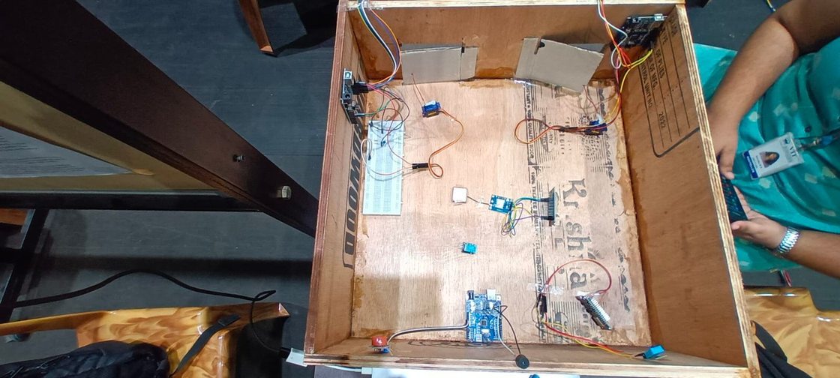
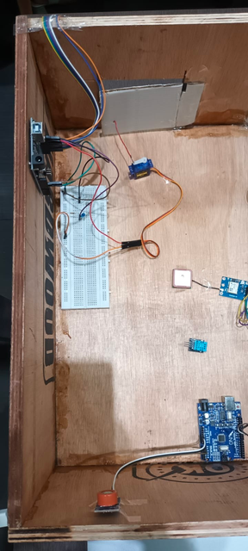
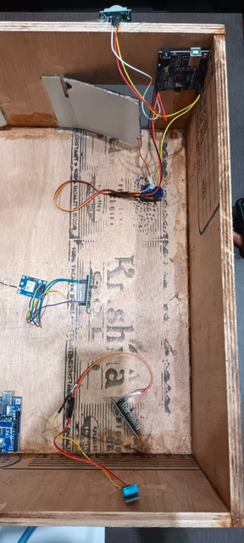
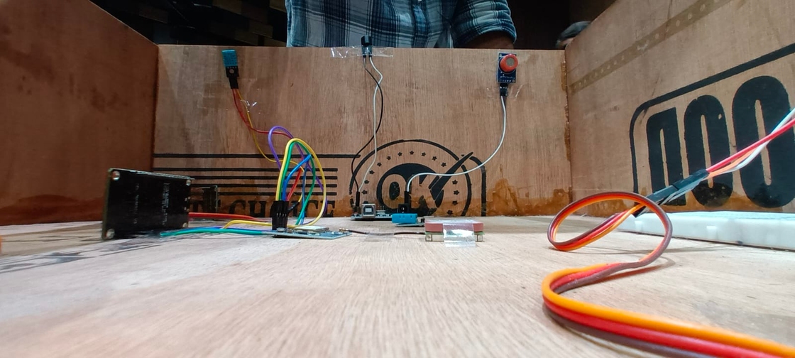
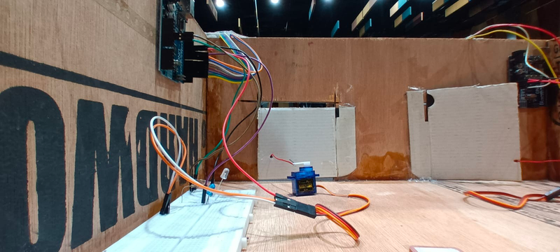
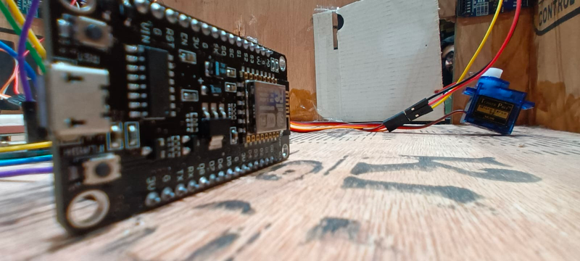
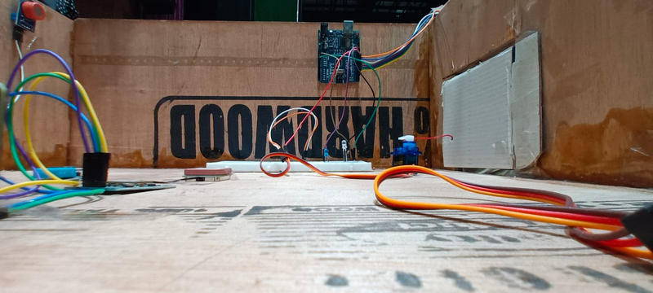
IMPLEMENTATION
~PROJECT PRESENTATION IN EXPO ON 06/04/23

Slide 11
SITE VISIT
During the site visit to Dazzle Cold Chain, 69, 2nd Main Rd, it was observed that they have successfully implemented an IoT-enabled risk monitoring system for their cold supply chain. The system uses sensors and devices to monitor temperature, humidity, and other environmental parameters during transportation of perishable goods. The data collected from sensors is processed and analysed in real-time using machine learning algorithms to detect potential risks. Real-time alerts are provided to relevant stakeholders in case of any anomalies or risks detected. A dashboard displays the status and location of products in transit, which is accessible to logistics managers, suppliers, and customers. The system has reduced risks and losses associated with the cold supply chain by providing timely information and alerts. It has also helped in maintaining the quality and safety of perishable goods during transportation. The stakeholders at Dazzle Cold Chain, including logistics managers and suppliers, were satisfied with the performance of the system. They reported that the system has helped in better decision-making and risk mitigation. It is recommended that Dazzle Cold Chain continue to monitor the performance of the system and conduct regular training and awareness programs for stakeholders to enhance their understanding of the system.
99% Malware Detection Removal
Learn More

Slide 12




References
We Have Over 500+ Reviews
https://stockarea.io/blogs/cold-storage/
https://www.internationalgasdetectors.com/gas-detection-solutions-cold-storage/
https://learn.adafruit.com/pir-passive-infrared-proximity-motion-sensor
Cold storage is a facility that primarily stores food items that are short-lived and highly likely to get spoilt under normal conditions....
Numerous accidents involving refrigerant gas leaks have been reported worldwide, hospitalizing hundreds, and killing several....
PIR sensors allow you to sense motion, almost always used to detect whether a human has moved in or out of the sensors range.....

Slide 13

THANK YOU!
Name
Email
Contact
Amritansh Anand
Sakshi Singh
Vaishnavi JS
Amrutha MS
Navya Kala SV
amritansh.anand2020@vitstudent.ac.in
sakshi.singh2020@vitstudent.ac.in
vaishnavi.js2020@vitstudent.ac.in
amrutha.ms2020@vitstudent.ac.in
navyakala.sv2020@vitstudent.ac.in
+91 - 9140358379
+91 - 6375021 973
+91 - 9222280898
+91 - 7659800569
+91 - 9494397757

